Slide 1
Thinking like an architect
ARCHITECTURE WORKSHOP · INTRODUCTION
Seven questions — and some established answers — before we open our product architecture.
[Presenter name] · [Date]
Notes:
Timing: 0:00–0:30. Welcome. The purpose of the next 30 minutes is not to teach a framework but to get into the architect’s mindset before we look at our own product. There are no wrong answers in this part — the aim is to notice how you think, and how differently people from software, hardware, IT, networks and business think about the same words. Running time plan (total about 30 minutes): intro 1.5 · Q1 3 · Q2 2.5 · concepts 2.5 · Q3 5 (pairs) · Q4 3 (optional) · Q5 5 (pairs) · Q6 3 · role map 3.5 · close 0.5. Optional humour to open: “Architecture is about the important stuff. Whatever that is.” (Ralph Johnson, quoted by Martin Fowler in “Who Needs an Architect?”). You can also save it for the reveal of question 1.

Slide 2
How this session works
BEFORE WE START
1 · A question
2 · Reflect
3 · Answers
One question per slide. Think before you look for an answer.
Mostly on your own; twice with your neighbour. Then call it out.
Established views, not ‘the’ answer. Disagreeing is welcome.
LENSES FROM YOUR READING
SAiP
ASA
CAiP
BEA
Software Architecture in Practice
The Art of Systems Architecting
Continuous Architecture in Practice
Building Evolutionary Architectures
Bass, Clements & Kazman
Maier & Rechtin
Erder, Pureur & Woods
Ford, Parsons, Kua & Sadalage
Notes:
Timing: about 1 minute. Explain the rhythm: a question slide appears on its own, so there is nothing to lean on. Mostly you will reflect alone for a minute, then call out what you came up with — with ten of us, we can simply talk. Twice we will discuss with the person next to you. Then I show some established answers. They are not “the” answer; they are lenses. Several come from the four books you have read — the abbreviations on this slide are used throughout. When a definition comes from your book, you are the expert in the room: add what the slide leaves out. We will also see ISO/IEC/IEEE 42010, the international standard for architecture description, which sits behind much systems engineering practice.

Slide 3

What is architecture?
QUESTION 1 OF 7
You have all worked with one — in hardware, software, networks or a business. What do they have in common?
Reflect alone · 1 minute
Notes:
Timing: 1 minute of silence, about 1 minute collecting answers (3 minutes including the reveal). Prompt if needed: “Think of an architecture you know well — a network, a board, a service landscape, an organisation. What makes it the architecture, rather than just a drawing of it?” Capture the words people use on a flipchart or whiteboard: structure, components, interfaces, principles, decisions, constraints, rules, layers… You will compare them with the definitions on the next slide. Don’t correct anyone yet.

Slide 4
What is architecture?
QUESTION 1 · ESTABLISHED ANSWERS
ISO/IEC/IEEE 42010:2022
SAiP
ASA
“Fundamental concepts or properties of an entity in its environment and governing principles for the realization and evolution of this entity and its related life cycle processes.”
“The set of structures needed to reason about the system. These structures comprise software elements, relations among them, and properties of both.”
“The structure — in terms of components, connections and constraints — of a product, process or element.”
International standard for architecture description
Bass, Clements & Kazman
Maier & Rechtin
Recurring ideas: structure · relationships · principles · environment · evolution
Notes:
Timing: about 1 minute. Read the three side by side and ask: which words from our flipchart appear here — and which of ours are missing? Points to draw out: • 42010 talks about an “entity”, not just software: a product, a system of systems, even an enterprise. It also includes environment and evolution — architecture is not a snapshot. (We return to this in question 4.) • SAiP: “needed to reason about” — architecture is chosen for a purpose, so there is no single complete architecture of anything. • ASA: constraints are part of the architecture, not just boxes and lines. Invite readers of SAiP and ASA to add context from their book. Humour (off slide): “Architecture is about the important stuff. Whatever that is.” — Ralph Johnson, quoted by Martin Fowler. BEA also cites the popular shorthand that architecture is the parts that are hard to change later — a theme that returns in question 4. Please check the exact wording of each quotation against the edition your group read before presenting.

Slide 5
Is an architecture the same thing as its description?
QUESTION 2 OF 7
And does every system have an architecture — even if nobody ever wrote it down?
Reflect alone · 1 minute
Notes:
Timing: 1 minute to reflect, 1 minute of responses (2.5 minutes including the reveal). Likely answers: “the description is the documents and diagrams”, “the real architecture is in people’s heads”, “the code (or the hardware) is the architecture”. Push with: • If every document were lost tomorrow, would the system still have an architecture? • If the documents say one thing and the running system does another, which one is the architecture?

Slide 6
Architecture vs. architecture description
QUESTION 2 · ESTABLISHED ANSWERS
Architecture as property
Architecture as concept
Architecture description
“A property or attribute of an entity of interest.”
“A conception of an entity in one’s mind.”
“Work product used to express an architecture.”
It is there whether or not anyone intended or wrote it down.
Two people can hold different ones of the same system.
Tangible — while the architecture itself is intangible and abstract.
ISO/IEC/IEEE 42010:2022, Annex A
ISO/IEC/IEEE 42010:2022, Annex A
ISO/IEC/IEEE 42010:2022
Gap 1 · between people
Gap 2 · intention vs. reality
Different conceptions of the same system: alignment.
Intended and realised architecture diverge: drift.
Notes:
Timing: about 1.5 minutes. Start from the room: who answered “yes, every system has an architecture”, and who said “the architecture is in our heads”? Both camps are represented on the slide. ISO/IEC/IEEE 42010:2022 deliberately does not choose. Its scope says an AD is a tangible work product, whereas “an architecture is intangible and abstract”. Annex A describes two metaphors — architecture as a property of the entity, and architecture as a conception in one’s mind — and states that its conceptual foundation “does not presume any one of these metaphors”. (Quotations taken from the 2021 draft (DIS) of the standard; check the wording against the published edition.) Background on the two views: • Property view: the older IEEE 1471-2000 tradition stated “every system has an architecture”, defined as the fundamental organisation of a system embodied in its components. SAiP takes a similar view — an architecture exists independently of its description, which is why architecture reconstruction from an existing system is possible. (Check the wording in your SAiP edition.) • Concept / social view: Martin Fowler, in “Who Needs an Architect?”, quotes Ralph Johnson — architecture as the expert developers’ shared understanding of the system design. Before anything is built, the architecture exists only as ideas, and those ideas can differ. Reconciling them: separate the intended architecture (in heads and, ideally, in an AD) from the realised architecture (what the system actually has). That gives two gaps to manage: • Gap 1, between people — alignment. This is what an AD is for: making conceptions explicit so they can be compared and agreed. In a new project this gap is often the largest. • Gap 2, between intention and reality — drift or erosion, through many small, individually reasonable decisions. This is what continuous checking is for (question 5 picks this up). Can we still speak of “the” architecture under the concept view? Yes — “the” architecture is then the conception that has been agreed and made authoritative, through a decision process and ideally an AD. Before that, there are several architectures in several heads; making it singular is part of the architect’s job. A conception is still a conception of something: the system pushes back, and a conception can simply be wrong about it. The two views also shape what we do when measurement shows a mismatch: prescriptive reading (AD as intent) — fix the system; descriptive reading (AD as an account of reality) — fix the AD. See the hidden backup slide “Conformance is not fitness” after question 5. 42010 also explains why one diagram never satisfies everyone: different stakeholders have different concerns, so a description needs several views (next slide). Humour (off slide): “Every system has an architecture. Some are undocumented; others are documented but fictional.” Or: “The map is not the territory — and our map was last updated three releases ago.”

Slide 7
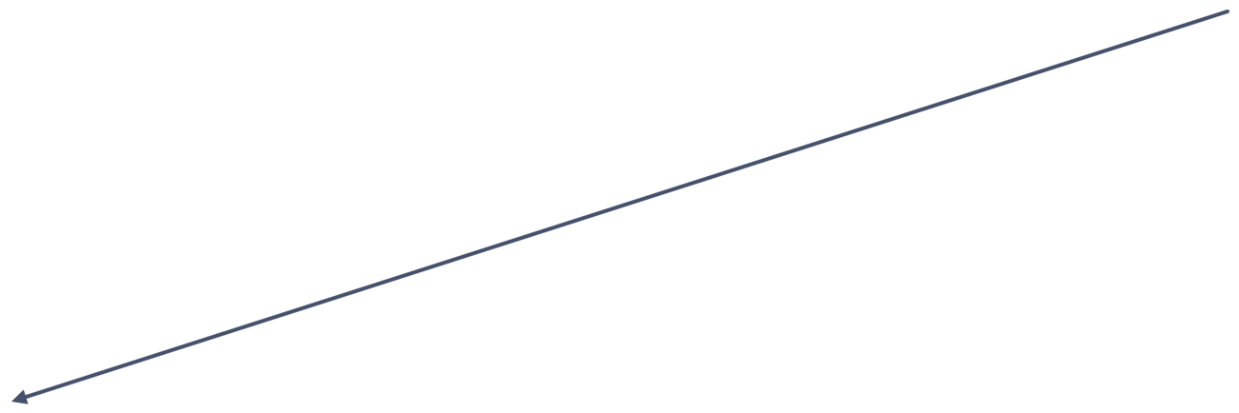
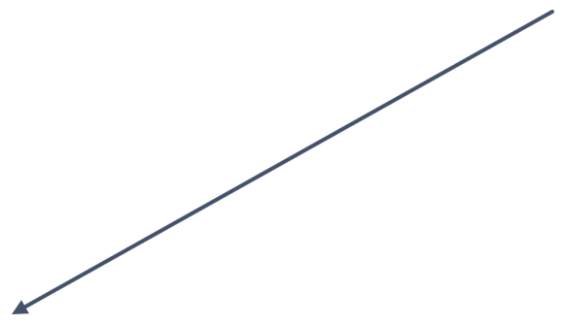
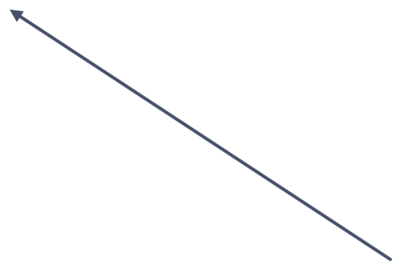
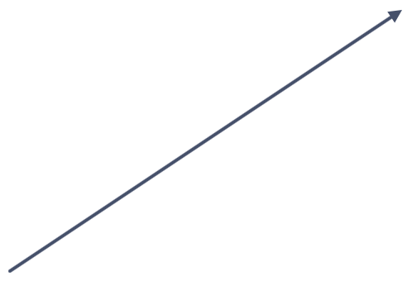
The concepts we architect with
VOCABULARY · AFTER ISO/IEC/IEEE 42010:2022
Environment
Stakeholder
sees things
from
Stakeholder perspective
is situated in
is a matter of
importance for
results in
has an interest in
has an interest in
Entity of interest
Architecture
Architecture description
Concern
has
expresses
is part of the
character or
nature of
is contained in
addresses
frames
Aspect
Architecture view
is evidenced in
governs
Architecture viewpoint
The entity and its architecture
Stakeholders and their concerns
The architecture description
Notes:
Timing: about 2.5 minutes. This follows naturally from question 2: once we separate the architecture from its description, we need words for what a description contains — and for who it is for. Optional reflection prompt (30 seconds, alone): “Which of these concepts do you already use in your field — perhaps under a different name?” (Systems engineers will recognise viewpoints and views from MBSE frameworks; software people from C4 or arc42; enterprise people from TOGAF.) How to read it — three groups, shown by colour: • The entity (dark, left): an entity of interest (2011 edition: “system”) is situated in its environment and has an architecture. Aspects are part of its character or nature — for example its structure, behaviour or cost. • The people (orange, top right): stakeholders have an interest in the entity and in its architecture. Each sees things from a stakeholder perspective, which results in concerns — and those concerns are matters of importance for the stakeholder. • The description (outlined, bottom right): an architecture description expresses the architecture. It contains architecture views. Each view is governed by an architecture viewpoint, which frames particular concerns; the view addresses those concerns, and aspects of the entity are evidenced in it. Two loops worth pointing out: • Stakeholder → perspective → concern → back to the stakeholder: concerns come from people, not from the system. • Viewpoint → view → concern: a view is only useful if it answers someone’s concern. One diagram never satisfies everyone because different stakeholders have different concerns — viewpoints are how we choose deliberately what to show to whom. Left out for simplicity: view components and model kinds (2011: “models”), correspondences between AD elements, and architecture decisions and rationale — all part of the standard’s full model. This is a simplified drawing, not a copy of the figure in the standard. If you have access to the standard, the full conceptual model figure is worth showing; check the relationship names against your copy before presenting.

Slide 8

What drives architecture?
QUESTION 3 OF 7
Two systems with the same functions can end up with completely different architectures. Why?
Discuss with your neighbour · 3 minutes
Notes:
Timing: 3 minutes in pairs, about 1 minute collecting (5 minutes including the reveal). First of the two pair discussions. Collect one or two drivers from each pair and cluster them as you go: • qualities — fast, safe, available, secure, easy to change… • constraints — cost, regulation, standards, legacy, suppliers • business goals — time to market, product line, who the customer is • people and organisation If nobody mentions the organisation, ask: would the architecture look different if the same system were built by one team in one room, or by five teams in three countries?

Slide 9
What drives architecture?
QUESTION 3 · ESTABLISHED ANSWERS
Quality attributes
Constraints
Business goals
The organisation
Performance, safety, security, modifiability… the qualities, not the functions.
Regulation, standards, legacy, cost: decisions already made for you.
Time to market, product-line strategy, the client’s purpose.
Teams shape the system, and the system shapes the teams.
SAiP · CAiP
SAiP · ASA
ASA · SAiP
CAiP · Conway’s law
CAiP · principle
ASA · heuristic (paraphrased)
SAiP (paraphrased)
“Focus on quality attributes, not on functional requirements.”
Don’t assume the original problem statement is the right one.
Qualities conflict; architecture makes the trade-offs explicit.
Notes:
Timing: about 1 minute. Map the pairs’ answers onto the four boxes. Architecturally significant requirements (ASRs), from SAiP: requirements that have a profound effect on the architecture. Most are quality attributes, and they are often not written down at all — the architect has to dig them out of stakeholders. CAiP makes quality attributes one of its six principles (quoted on the slide). ASA reminds us that the client may not yet know what they want; part of architecting is helping them find out, so question the problem before solving it. The organisation: Melvin Conway (1968) — “Any organization that designs a system … will produce a design whose structure is a copy of the organization’s communication structure.” CAiP turns this into a principle: model the organisation of your teams after the design of the system you are working on. SAiP describes the same two-way influence as the architecture influence cycle. Humour (off slide): “Fast, cheap, good — pick two. Architects get asked for all three, plus secure.”

Slide 10
Is an architecture ever finished?
QUESTION 4 OF 7
When should the important decisions be made — as early as possible, or as late as possible?
Reflect alone · 1 minute
Notes:
Timing: 1 minute to reflect, 1 minute of responses (3 minutes including the reveal). If you are short of time, skip this question and its answer slide; the point resurfaces in question 5. Expect a split by background: systems engineering tends towards “decide early, baseline, control change”; software and agile backgrounds tend towards “decide late, evolve”. Let the two camps argue briefly — that tension is the point of the question, and it is exactly the shift towards a more continuous mindset we want to explore today.

Slide 11
Is an architecture ever finished?
QUESTION 4 · ESTABLISHED ANSWERS
ASA · heuristic
CAiP · principle
BEA · definition
“All the serious mistakes are made in the first day.”
“Delay design decisions until they are absolutely necessary.”
“An evolutionary architecture supports guided, incremental change across multiple dimensions.”
Early decisions carry the most leverage — and the most risk.
Architect for change: keep decisions small and reversible.
Maier & Rechtin
Erder, Pureur & Woods
Ford, Parsons, Kua & Sadalage
Can both be true? Which of our decisions are hard to reverse — and which could we keep open?
Notes:
Timing: about 1.5 minutes. Don’t resolve it — hold the tension and let the room react. A reconciling thought, if the room wants one: decide the few hard-to-reverse things early and deliberately (ASA); keep everything else open for as long as that is cheap (CAiP); and protect what matters with checks, so that change stays safe (BEA — next question). BEA describes architectures with no end state, designed to evolve, with built-in protection of important characteristics. Note that 42010 (question 1) already included “evolution” in its definition of architecture — this is not only an agile idea. CAiP’s six principles, for reference: architect products, not just projects; focus on quality attributes, not functional requirements; delay design decisions until they are absolutely necessary; architect for change — leverage the “power of small”; architect for build, test, deploy and operate; model the organisation of your teams after the design of the system. Humour (off slide): “An architecture is finished when the product is switched off — and sometimes not even then. Ask anyone still maintaining a legacy interface.”

Slide 12
How would you know your architecture is still good — today?
QUESTION 5 OF 7
Not at the next review gate. What could you observe or measure, and how often?
Discuss with your neighbour · 3 minutes
Notes:
Timing: 3 minutes in pairs, about 1 minute collecting (5 minutes including the reveal). Second and last pair discussion. This is the bridge to the Goal-Question-Metric workshop later today: write their candidate measures on a flipchart and keep it for the afternoon. Push with: good for whom? Which quality? Measured how — and who would act on the result? Typical answers: review outcomes, test results, build and integration times, field defects, response times, coupling or dependency metrics, cost or lead time per change, how long it takes to onboard a new engineer, how often interfaces break.

Slide 13

Making ‘good’ observable
QUESTION 5 · ESTABLISHED ANSWERS
SAiP · quality attribute scenario
BEA · fitness function
CAiP · essential activities
Source · stimulus · environment · artefact · response · response measure
“An architectural fitness function provides an objective integrity assessment of some architectural characteristic(s).”
Focus on quality attributes, drive architectural decisions, manage technical debt — and implement feedback loops.
The response measure turns a quality from an adjective into something testable.
Bass, Clements & Kazman
Ford, Parsons, Kua & Sadalage
Erder, Pureur & Woods
Later today: Goal → Question → Metric for our own product.
Notes:
Timing: about 1 minute. Compare with the measures on the flipchart. SAiP example of a full scenario: “When a node fails during peak load (stimulus, environment), the system fails over (response) within two seconds with no lost transactions (response measure).” Without the response measure, “highly available” is only an adjective. BEA: Rebecca Parsons stresses that the result of a fitness function must be something two people cannot disagree about. “Maintainable” cannot be a fitness function; “no cyclic dependencies between modules” or “95th-percentile response under 200 ms” can. Fitness functions can be automated in the pipeline or manual, atomic or holistic, continuous or periodic. CAiP: feedback loops are what make architecture continuous rather than a phase; managing technical debt is the other side of the same coin. Two kinds of measurement — worth naming if the flipchart is all one kind: • Conformance: does the system match the intended architecture in the AD? (dependency rules, layering, interface contracts) • Fitness: does the architecture meet its goals? (response measures, availability, lead time per change) A system can conform perfectly to a poor architecture. Fitness functions cover both; GQM starts from goals, so it leads naturally to fitness measures. When a conformance check fails, decide explicitly: fix the system (the AD states intent) or update the AD (the system was right). The hidden backup slide that follows has the comparison table. Hand-over: GQM gives us a disciplined route from a goal, through the questions that matter, to the metrics that answer them — that is this afternoon. Humour (off slide): “Without a measure, ‘the architecture is fine’ is an opinion. With one, it is still an opinion — but a better-informed one.”

Slide 14
What is an architect?
QUESTION 6 OF 7
What does an architect do that a senior expert does not — and what would you have to let go of?
Reflect alone · 1 minute
Notes:
Timing: 1 minute to reflect, 1 minute of responses (3 minutes including the reveal). This is the most personal question for this group — everyone in the room is moving towards an architecting role. Invite honesty about what they would miss (deep technical work, being the person who knows the answer) and what worries them (influence without authority, being seen as “a generalist”, more meetings).

Slide 15
What is an architect?
QUESTION 6 · ESTABLISHED ANSWERS
ASA
SAiP
CAiP
The client’s agent: helps the client find out what they need and can afford, and certifies that the result is fit for purpose.
Technical breadth matters, but much of the job is communication, negotiation and leadership — with stakeholders who want different things.
Architecture is a flow of decisions. The architect leads them — and gets the teams doing architecture work, not just the architect.
Maier & Rechtin (paraphrased)
Bass, Clements & Kazman (paraphrased)
Erder, Pureur & Woods (paraphrased)
From expert to architect: depth → breadth · deciding → influencing · how → why
Notes:
Timing: about 1.5 minutes. ASA’s idea of the architect as the client’s agent comes from building architecture: the architect represents the client’s interests, not the builder’s, and judges whether the result is fit for its purpose. SAiP spends a whole chapter on the architect’s duties, skills and knowledge — many of them non-technical. CAiP lists “provide leadership” as an essential activity: leading rather than managing, and getting the team doing the architecture work. The architectural decision is the unit of work. The bottom line on the slide is a common observation rather than a quotation — ask the room whether it matches what they said they would have to let go of. Worth mentioning, although not from the four books: Gregor Hohpe’s “Architect Elevator” — the architect rides between the penthouse (strategy) and the engine room (implementation). It leads straight into the next slide. Humour (off slide): “An architect is someone who answers ‘it depends’ — and then explains on what.”

Slide 16
Where do these architects sit?
QUESTION 7 OF 7 · CALL IT OUT
Big picture
Where does each role belong — and how far does its reach extend?
ARCHITECT ROLES
Enterprise
Business
Solution
Systems
Software
Hardware
Network
Security
Detail
Business / enterprise
Products
Notes:
Timing: about 2 minutes. A shout-out exercise — no pairs, no drawing. Point at one role at a time and ask “where?”. If you present from PowerPoint in edit view, drag the chips onto the chart as people call out; otherwise just point and gesture. Encourage disagreement: “Shouldn’t it be above that one?”, “Is that the same in our organisation?” For each role also ask: how big is its bubble — how far does its influence reach, horizontally and vertically? The next slide shows architects as figures with a bubble of reach behind them. “Systems” means the systems architect in the systems engineering sense. “Network” includes infrastructure. Feel free to add your organisation’s own titles (for example product, domain, data, cloud or chief architect). Humour (off slide): “If anyone wants to put a role in all four corners at once, that’s either a chief architect or a job advert.”

Slide 17

Where do these architects sit?
QUESTION 7 · ONE POSSIBLE PICTURE
Big picture
Draw the bubble, not the dot.
Enterprise
Systems
Most roles span a range; the overlaps are where architects need each other.
Solution
Business
Titles vary more between organisations than between books.
Security
Software
Where is your bubble today — and where do you want it to be?
Network
Hardware
Detail
Business / enterprise
Products
Notes:
Timing: about 1.5 minutes. Present this as one possible picture, not the answer — compare it with what the room said and invite challenge. How to read it: each figure is an architect role; the bubble behind it is its typical reach. Wide bubbles reach across the organisation; tall bubbles reach from detail to the big picture. Points to draw out: • Enterprise and business architects work across the organisation, towards the big-picture end. • Solution architects bridge business needs and products — a wide bubble in the middle. • Systems architects own the big picture of a product; software and hardware architects go deeper within it. • Network and security architects cut across — security often spans the whole width. Your organisation may well draw it differently; that difference is worth discussing. End on the personal question: where is your bubble today — and where do you want it to be by the end of this programme? Humour (off slide): “If your bubble covers the whole chart, congratulations — you are either the chief architect or the only architect.”

Slide 18
Three questions to carry into the day
BEFORE WE OPEN OUR PRODUCT ARCHITECTURE
Which decisions in our product would be most expensive to change?
What drives them — qualities, constraints, business goals or the organisation?
How would we know, continuously, that they still hold?
Next: our product architecture →
Notes:
Timing: about 30 seconds. These three questions are the thread through the rest of the day: we will use them when we walk through the product architecture, and the third one is exactly what the Goal-Question-Metric workshop answers. Consider leaving this slide up, or writing the three questions on a flipchart, so you can point back to them later.

